Slide 1
Diamond Price Analysis
Supervised Machine Learning
Milan Patel

Slide 2
Objective
The goal is to apply and compare Linear Regression and other multiple supervised machine learning algorithms, including Ridge Regression, Lasso Regression, Decision Tree, Random Forest, Gradient Boosting, and XGBoost, to develop a robust predictive model for diamond prices.

Slide 3
Base Plan
Read the diamond csv file and create a dataframe for it.
Cleaning out the rows that have the values of zero in any numerical features. Normalizing numerical features using Standard scaler and one hot encoding the categorical features so that they can be included in analysis.
EDA: plotting box plots and facet grid of each categorical feature vs price and then analyzing them, pairplot of numerical features in order to understand their relations.
Looking for multicollinearity using correlation heatmap and VIF table.
Applying Simple Linear Regression algorithm on the dataset, doing some feature engineering and using interactive features and then analyzing the result using ols stats summary and plotting actual vs predicted graph.
Applying L1 and L2 regularization using Ridge and Lasso Regression.
Applying rest of the supervised models (Decision Tree, Random Forest, Gradient Boosting and XGBoost) and then comparing R2 and RMSE values.

Slide 4
Dataset Columns
price: price in US dollars ($326 - $18,823)
carat: weight of the diamond (0.2 - 5.01)
cut: quality of the cut (Fair, Good, Very Good, Premium, Ideal)
color: diamond colour, from J (worst) to D (best)
clarity: a measurement of how clear the diamond is (I1 (worst), SI2, SI1, VS2, VS1, VVS2, VVS1, IF (best))
x: length in mm (0 -10.74)
y: width in mm (0 - 58.9)
z: depth in mm (0 - 31.8)
depth: total depth percentage = z / mean(x, y) = 2 * z / (x + y) (43 - 79)
table: width of top of diamond relative to widest point (43 - 95)

Slide 5
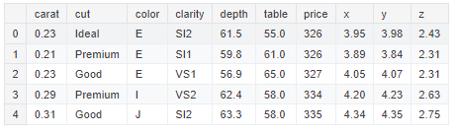
Dataset

Slide 6
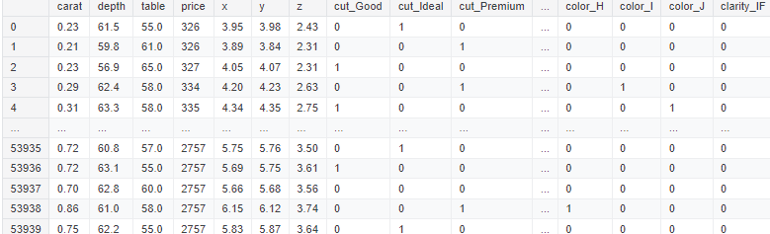
Dataset after One-hot Encoding

Slide 7
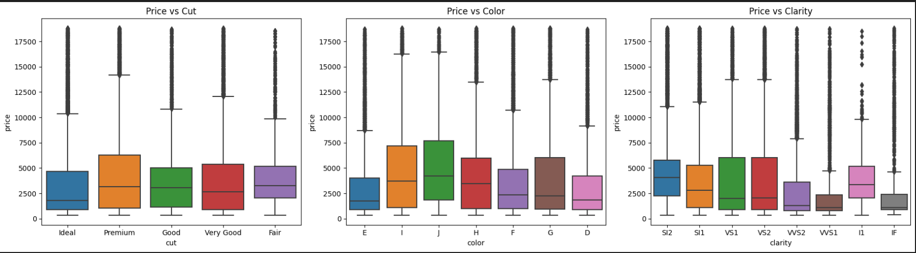
Boxplots of Price vs. Categorical Features

Slide 8
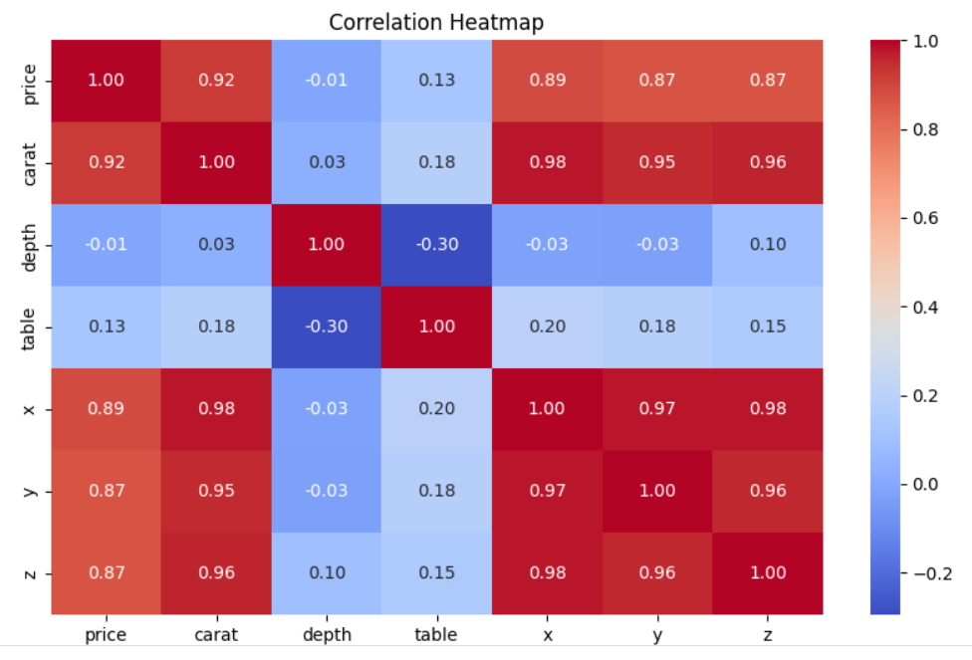
Correlation Heatmap of Numerical Features

Slide 9
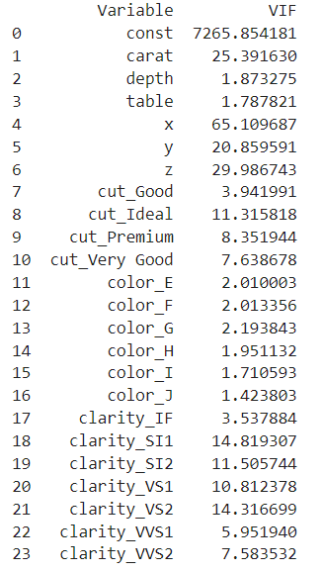
VIF Values to check for multicollinearity

Slide 10
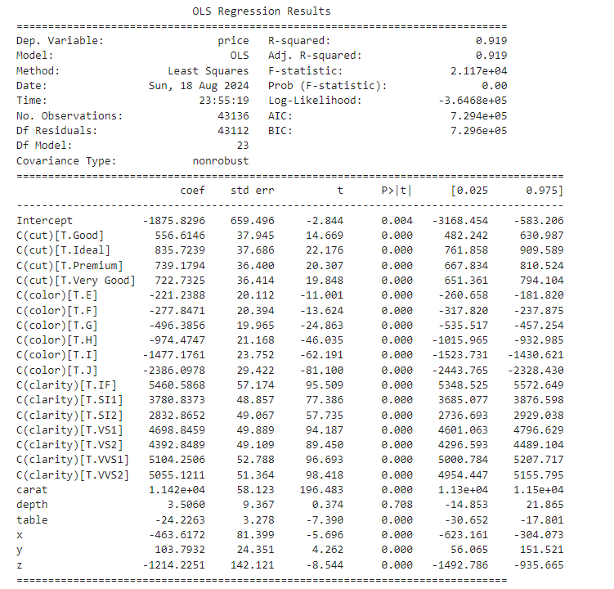
Simple Linear Regression Summary

Slide 11
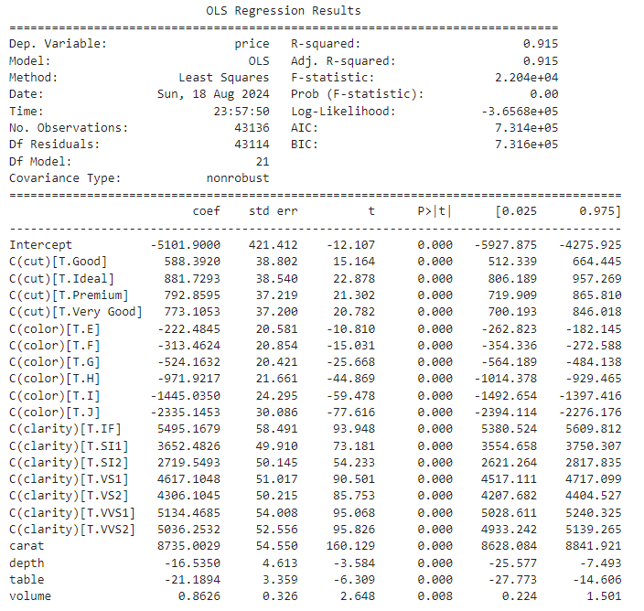
Simple LR with Feature Engineering Summary
( volume = x * y * z )

Slide 12
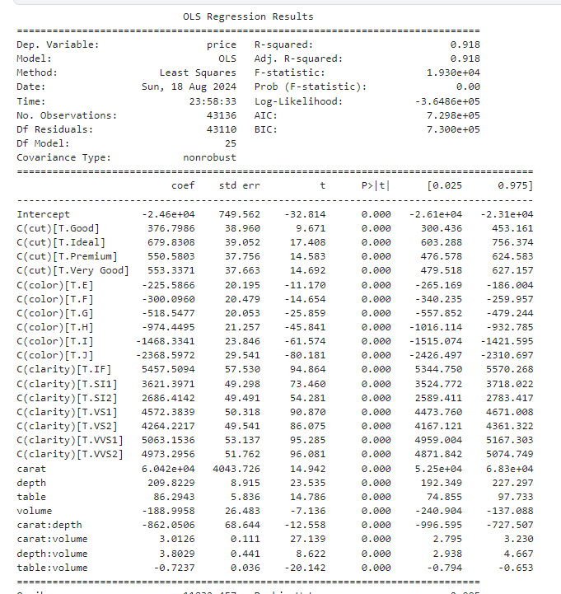
Simple LR with interaction features summary

Slide 13
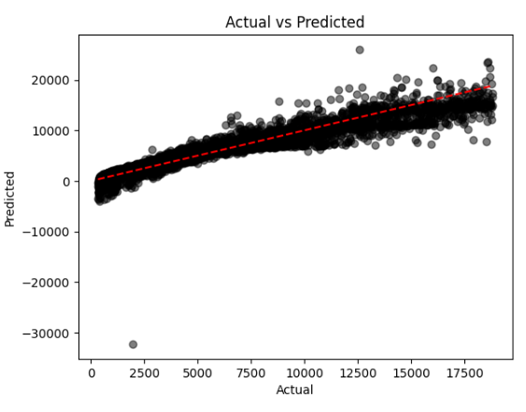

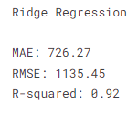
Lasso Regression

Slide 14
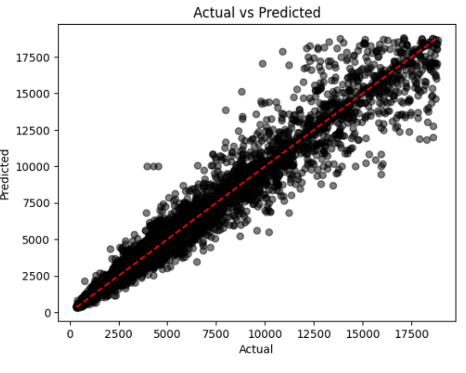
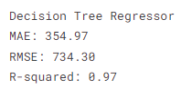

Slide 15
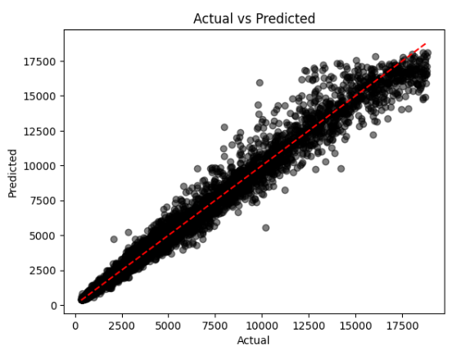
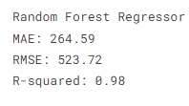

Slide 16
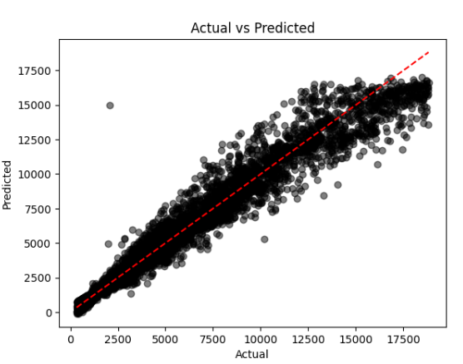
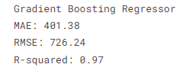

Slide 17
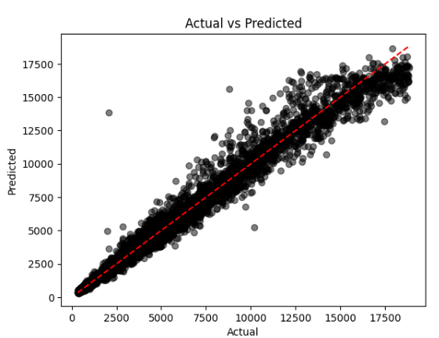
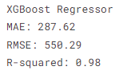

Slide 18
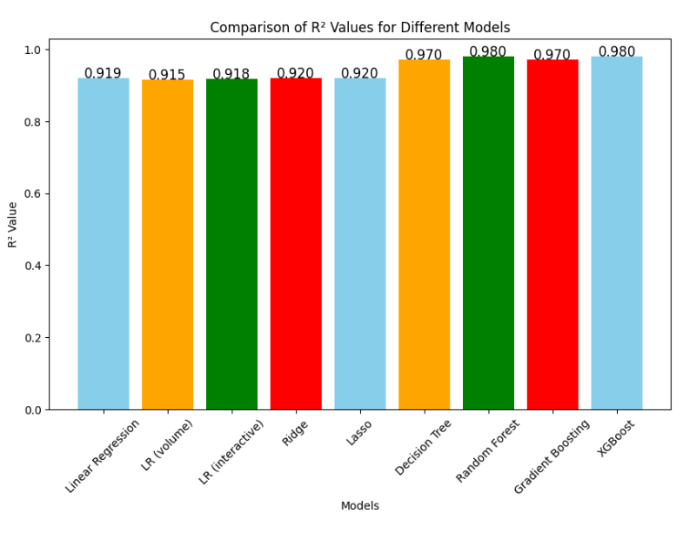
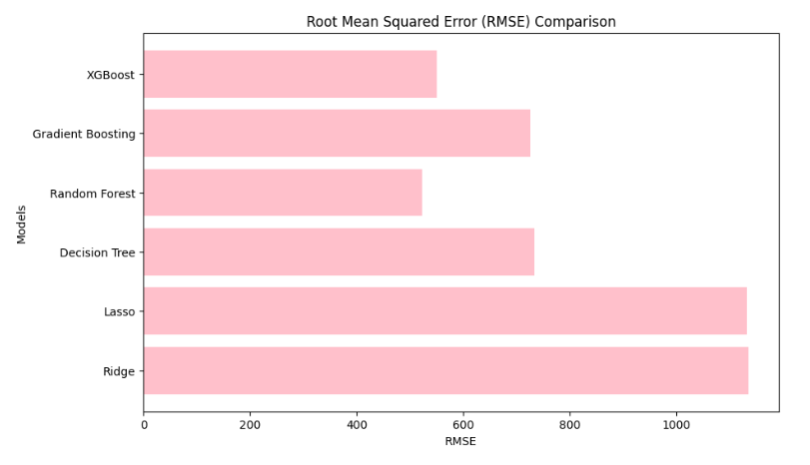
Model Comparison

Slide 19
Summary
Every Model performed quite well on this dataset. This might be due to a less complex dataset.
Random Forest Regressor and XGBoost Regressor are the best models in terms of both accuracy (lower MAE and RMSE) and goodness-of-fit (R-squared).
Decision Tree performs well but is outperformed by ensemble methods like Random Forest and XGBoost.
Simple LR, Ridge and Lasso perform similarly but are less accurate compared to the tree-based models

Slide 20
Takeaways
I experimented with several variations of linear regression models: the standard Linear Regression, Linear Regression with Feature Engineering (calculated as volume=x×y×z), and Linear Regression with interaction terms. Linear models are useful when dealing with data that is linear in nature or when interpretability is crucial. However, for more complex datasets, non-linear models might be more appropriate.
While these approaches provided insights into the relationships within the data, they were ultimately outperformed by more sophisticated models like Random Forest and XGBoost. This highlights the importance of exploring both feature engineering and non-linear models to fully capture the complexity of the dataset.

